Slide 1

Greetings !

Slide 2

SELF BASKET
We Introduce

Slide 3
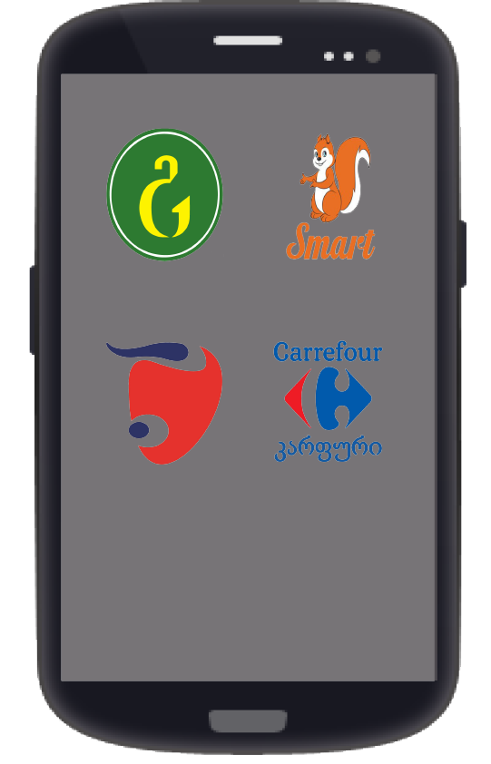
Choose Desired Market

Slide 4



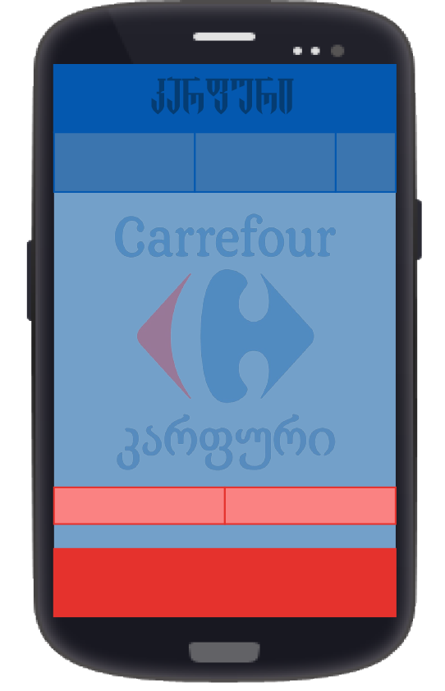
All Markets have Corresponding Unique Design

Slide 5
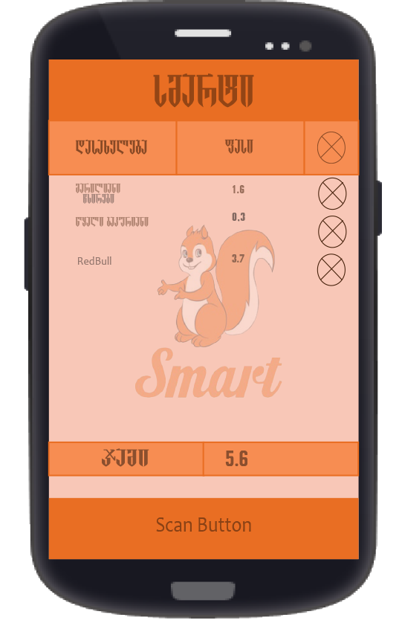
Scan Button Launches Camera to Scan Barcode
Product Name and Price is Automatically added
Total Price is Calculated

Slide 6
THANK YOU FOR ATTENTION !

